Slide 1
ANDROID
FINAL PROJECT
ＲＥＣＩＰＥ
資工二 107590015 謝安怡
資工二 107590042 崔元煜

Slide 2

開發動機
ANDROID FINAL PROJECT RECIPE
因現代資訊普級
當代的年輕人有更多機會接觸到做菜的資訊
也越來越多人會做菜
但大多數人還是喜歡依照食譜上的做法做
然而得到食譜的方式不外乎是上網搜尋
因此我們的目標為整合所有食譜
使那些想做菜的人們能更方便且更有目標性的在我們的APP裡學習到食譜
CONTENTS. A
75%
CONTENTS. A
75%

Slide 3

APP功能
ANDROID FINAL PROJECT RECIPE
搜尋食譜
1
2
簡易倒數計時器
可輸入關鍵字
來幫助尋找食譜
CONTENTS. A
75%
額外的倒數計時器功能
貼心提醒使用者菜餚已完成
3
4
新增食譜
CONTENTS. A
75%
加入最愛
使用者可自行新增食譜
與其他使用者共享佳餚秘方
內容為使用者喜歡的食譜
使用者可將食譜加入最愛清單

Slide 4
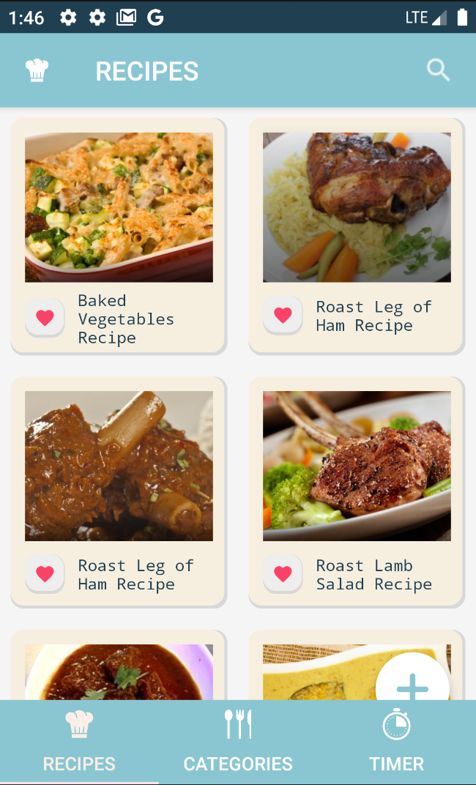


設計概念
ANDROID FINAL PROJECT RECIPE
色調活潑可愛
色彩配色參考配色網站
打造活潑可愛風格的APP
#8ac6d1
#204051
#faeee7
#f6eedf
操作簡單畫面精緻
食譜都已 CardView 呈現
視覺回饋使用到許多Animation
按鈕ICON統一
BUTTON幾乎都有使用ICON
增加可讀性、操作一目瞭然

Slide 5
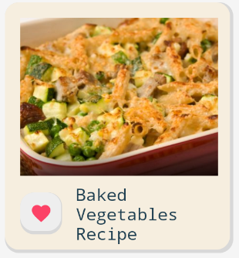
GUI
ANDROID FINAL PROJECT RECIPE
1
2
Ｍain 主頁
1
3
1
1
Navigation 導航
ImageView 食譜預覽
2
ToolBar 搜尋 （未完成）
2
Button 加入最愛清單
CardView 卡片瀏覽
3
TextView 食譜名稱
3
2
3
4
TabLayout 功能切換
5
FloatingActionButton 新增食譜 （未完成）
4
5

Slide 6
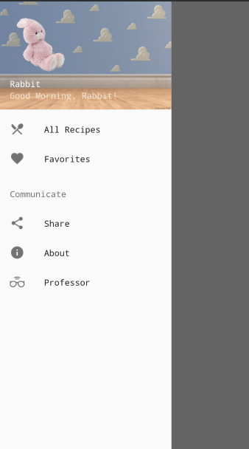
GUI
ANDROID FINAL PROJECT RECIPE
1
Navigation 導航
2
1
LinearLayout 會員資訊
3
2
Menu Item 所有食譜
4
5
3
Menu Item 最愛清單
6
4
Menu Item 分享
5
Menu Item 關於
6
Menu Item 指導教授

Slide 7
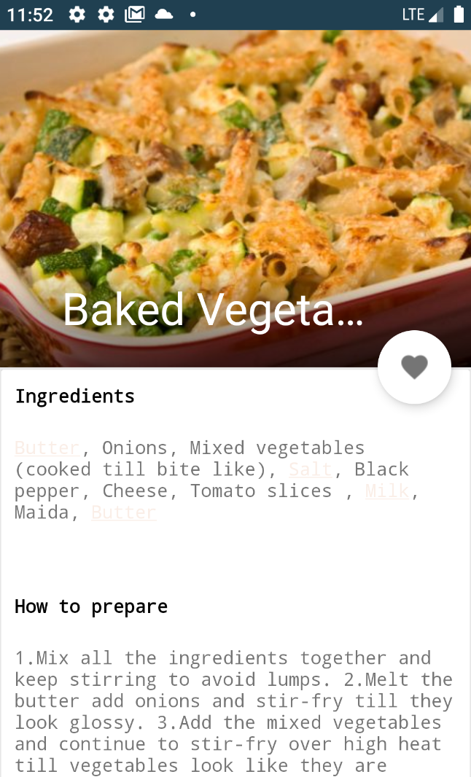
GUI
ANDROID FINAL PROJECT RECIPE
1
Recipe Detail 食譜內容
1
CoordinatorLayout 食譜標題
2
3
2
FloatingActionButton 加入最愛清單
3
ScrollView 材料與步驟

Slide 8
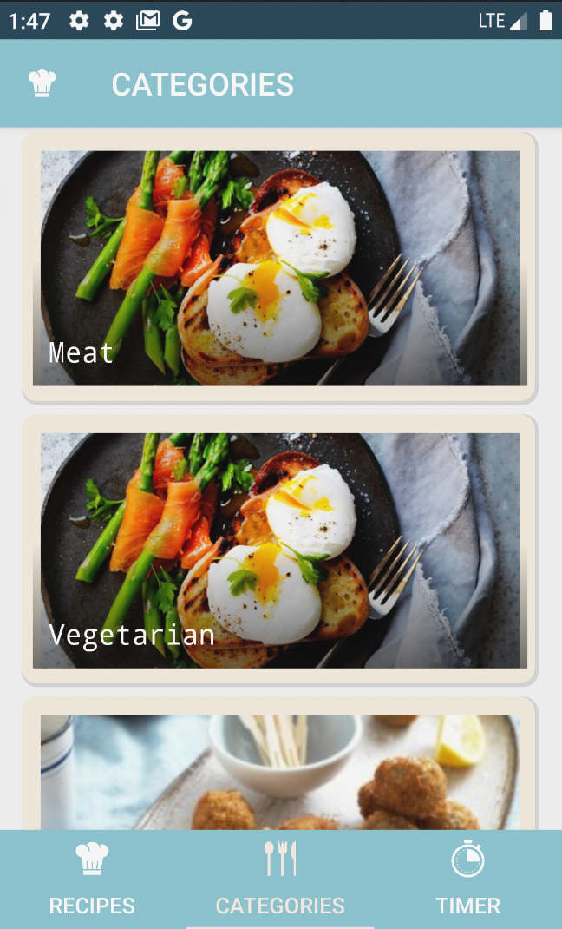
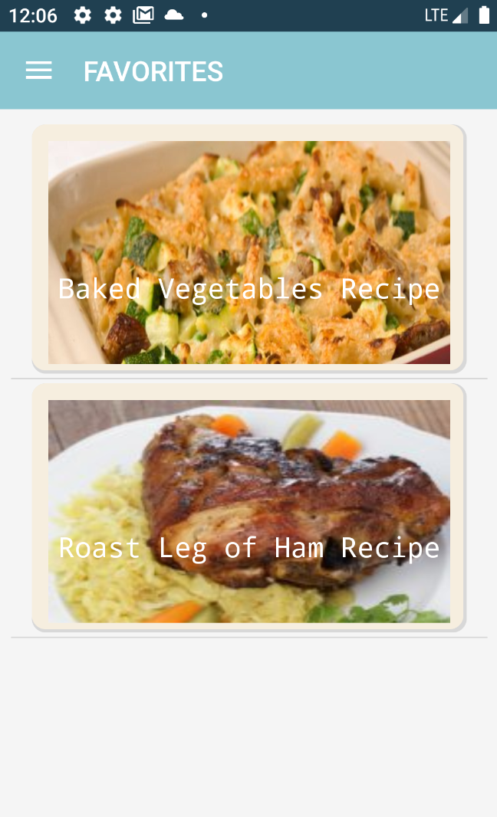
GUI
ANDROID FINAL PROJECT RECIPE
Favorite 最愛清單
1
Category 分類
1
1
RecycleView 食譜預覽

Slide 9
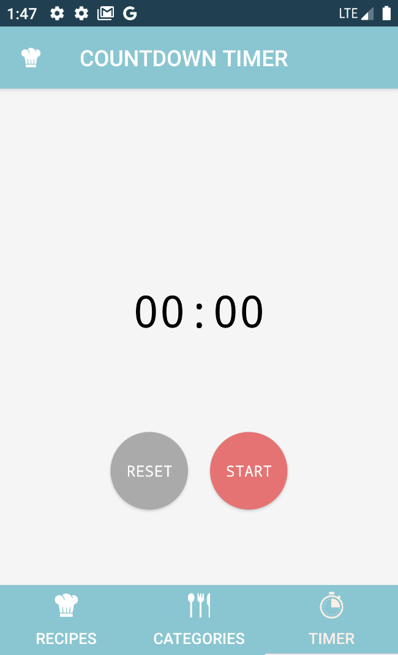
GUI
ANDROID FINAL PROJECT RECIPE
1
CountDown Timer
倒數計時器
1
Navigation 導航
2
3
2
ToolBar 搜尋 （未完成）

Slide 10
GUI
ANDROID FINAL PROJECT RECIPE
1
Ｍain 主頁
1
Navigation 導航
2
3
2
ToolBar 搜尋 （未完成）

Slide 11
GUI
ANDROID FINAL PROJECT RECIPE
1
Ｍain 主頁
1
Navigation 導航
2
3
2
ToolBar 搜尋 （未完成）

Slide 12
APP功能
ANDROID FINAL PROJECT RECIPE

Slide 13
POWER POINT PRESENTATION
ANDROID FINAL PROJECT COOK BOOK
CONTENTS A
컨텐츠에 대한 내용을 적어요
Enjoy your stylish business and campus life with BIZCAM
75%
CONTENTS A
컨텐츠에 대한 내용을 적어요
Enjoy your stylish business and campus life with BIZCAM
CONTENTS A
컨텐츠에 대한 내용을 적어요
Enjoy your stylish business and campus life with BIZCAM
CONTENTS A
컨텐츠에 대한 내용을 적어요
Enjoy your stylish business and campus life with BIZCAM

Slide 14
ANDROID FINAL PROJECT RECIPE
設計概念
CONTENTS. A
75%
CONTENTS. A
75%

Slide 15
ANDROID FINAL PROJECT RECIPE
GUI
CONTENTS. A
75%
CONTENTS. A
75%

Slide 16
ANDROID FINAL PROJECT RECIPE
GUI
1
Navigation Menu
RECIPE 食譜
導航選單
CONTENTS. A
75%
2
1
ToolBar
搜尋食譜按鈕
ViewPager
2
Favorite Button
各式食譜
CONTENTS. A
75%
將食譜新增至最愛清單
3
FloatingActionButton
3
新增食譜
TabLayout
功能頁面切換

Slide 17
ANDROID FINAL PROJECT RECIPE
GUI
CATEGORIES 分類
CONTENTS. A
75%
ViewPager
食譜種類
CONTENTS. A
75%

Slide 18
ANDROID FINAL PROJECT RECIPE
GUI
TIMER 計時器
CONTENTS. A
75%
1
Rest Button
TextView
重設時間
時間顯示
2
Start Button
1
2
CONTENTS. A
75%
開始倒數計時

Slide 19
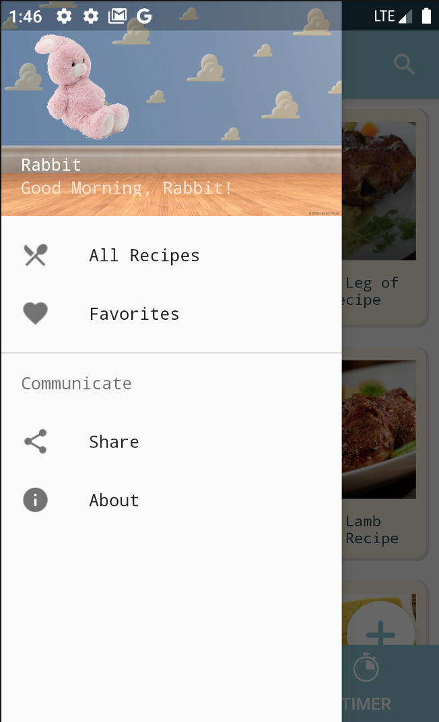
ANDROID FINAL PROJECT RECIPE
GUI
NAV 導覽
membership
顯示會員資訊
CONTENTS. A
75%
CONTENTS. A
75%

Slide 20
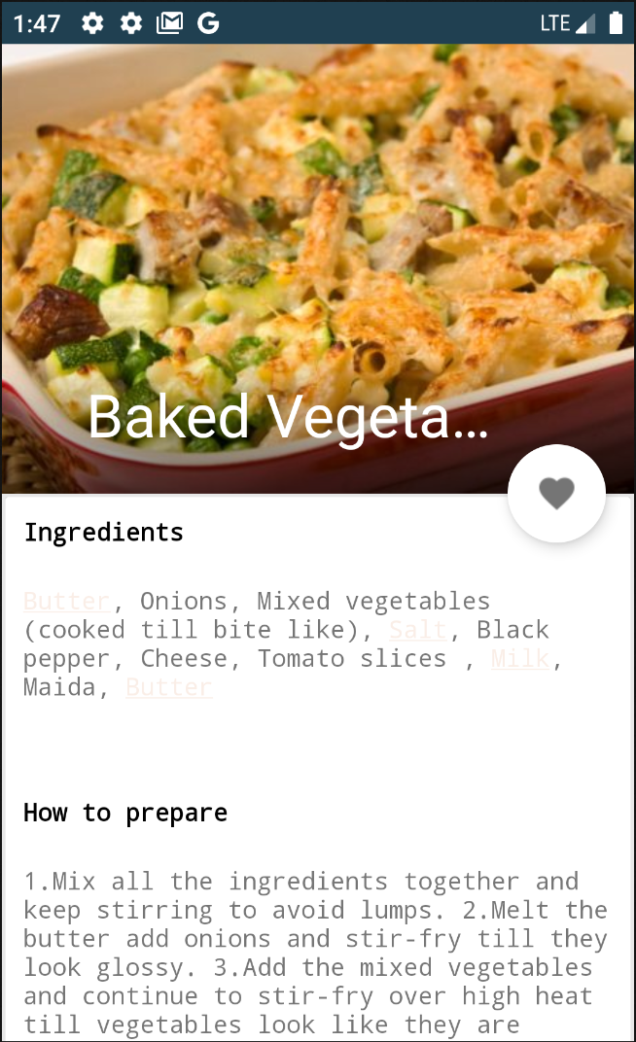
ANDROID FINAL PROJECT RECIPE
GUI
RECIPE DETAIL 食譜資料
CONTENTS. A
75%
1
FloatingActionButton
1
將食譜新增至最愛清單
CONTENTS. A
75%

Slide 21
ANDROID FINAL PROJECT RECIPE
FUNCTIONALITY AND CLASSES
FUNCTIONALITY | CLASSES
NavigationView | MainActivity FavoriteFragment AboutActivity
TabPager | HomeTabFragment TabPagerAdapter
Recipe | RecipesFragment RecipeRecyclerViewAdapter, AddRecipeActivity RecipeDetailsActivity
Category | CategoryFragment RecipesByCategoryActivity
Countdown Timer | CountdownFragment
Favorite | FavoriteFragment FavoriteRecyclerViewAdapter FavouriteDbHelper
Model | SquareImageView
CONTENTS. A
75%
1
developed mostly by myself
copy and modify
CONTENTS. A
75%
simply reuse
B

Slide 22
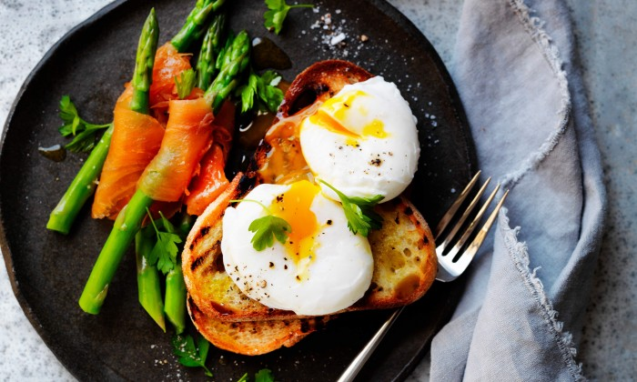








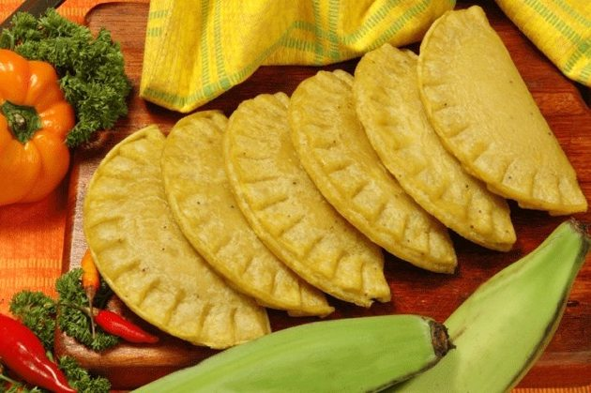







ANDROID FINAL PROJECT RECIPE
DRAWABLE copy and modify
ic_recipes.png
rating.png
recipe.png
ic_favorite.png
cat_default.jpg
eating.png
fruits.png
ic_about.png
CONTENTS. A
75%
spoon.png
professor.png
ic_share.png
Ic_favorited.png
1
plus.png
category_default.jpg
countdown.png
CONTENTS. A
75%
rabbit.png
category_default.jpg

Slide 23
ANDROID FINAL PROJECT RECIPE
DRAWABLE developed mostly by myself
button_favorite.xml
button_blue.xml
CONTENTS. A
75%
button_click.xml
button_red.xml
1
button_create.xml
circular.xml
CONTENTS. A
75%
round_corner.xml
drawer_top_gradient.xml

Slide 24

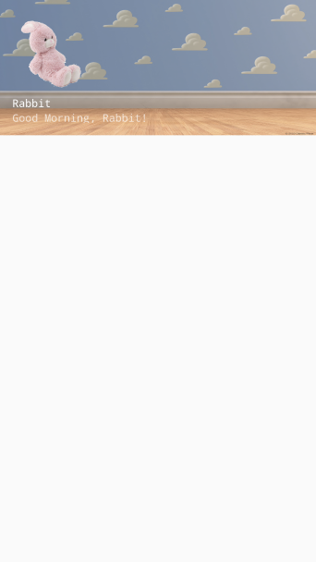
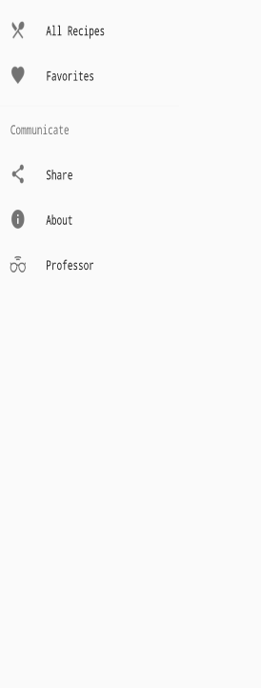
ANDROID FINAL PROJECT RECIPE
LAYOUT
CONTENTS. A
75%
1
CONTENTS. A
75%
toolbar.xml
nav_header_main.xml
activity_main_drawer.xml
activity_main.xml

Slide 25

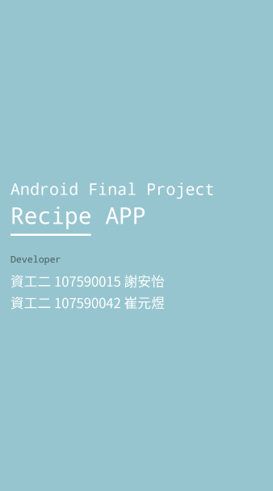
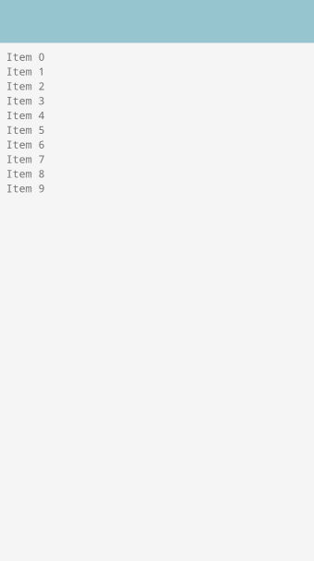
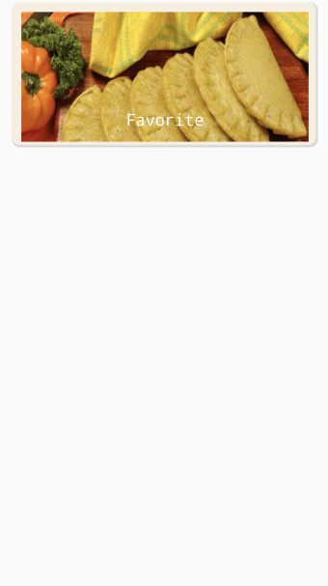
ANDROID FINAL PROJECT RECIPE
LAYOUT
CONTENTS. A
75%
1
CONTENTS. A
75%
fragment_home_tab.xml
activity_about.xml
fragment_favorite.xml
layout_favorite_row.xml

Slide 26
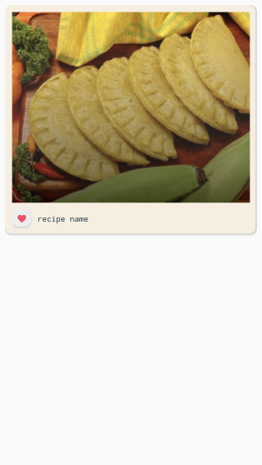
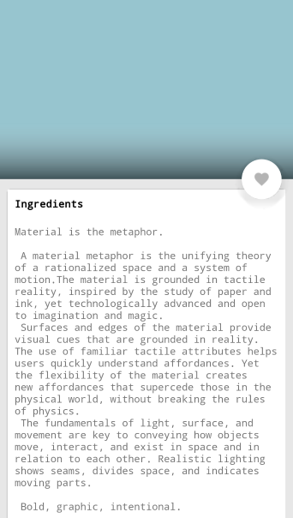
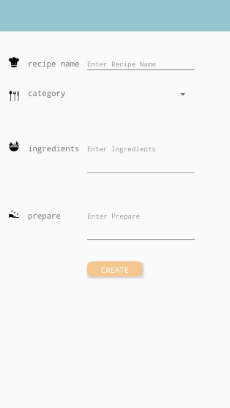
ANDROID FINAL PROJECT RECIPE
LAYOUT
CONTENTS. A
75%
1
CONTENTS. A
75%
fragment_recipes.xml
layout_recipe_row.xml
activity_recipe_details.xml
activity_add.xml

Slide 27
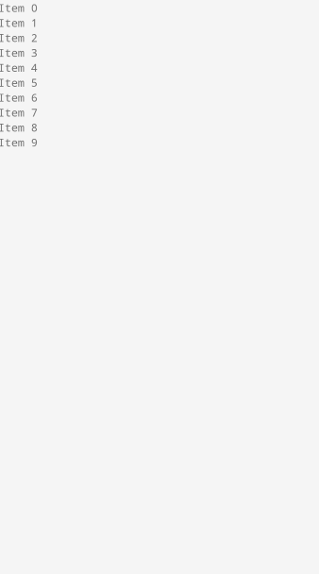
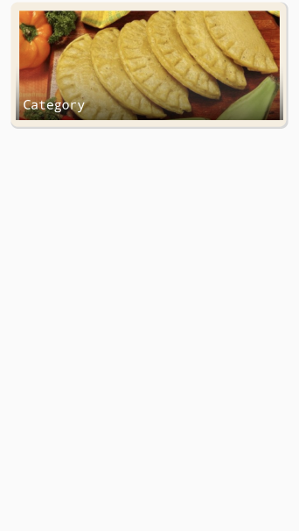
ANDROID FINAL PROJECT RECIPE
LAYOUT
CONTENTS. A
75%
1
CONTENTS. A
75%
activity_recipes_by_category.xml
fragment_category.xml
layout_category_row.xml

Slide 28
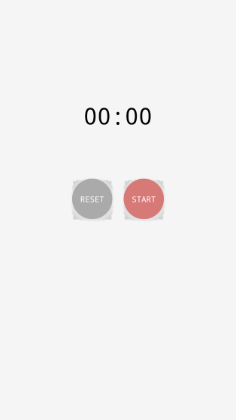
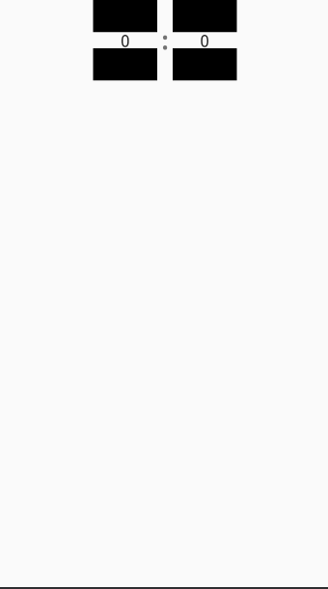
ANDROID FINAL PROJECT RECIPE
LAYOUT
CONTENTS. A
75%
1
CONTENTS. A
75%
fragment_countdown.xml
activity_add.xml

Slide 29
ANDROID FINAL PROJECT RECIPE
VALUE string
app_name
RECIPES
nav_header_desc
Navigation header
CONTENTS. A
75%
navigation_drawer_open
Open navigation drawer
action_settings
Settings
navigation_drawer_close
Close navigation drawer
notification_title
倒數計時器
1
nav_header_title
Rabbit
notification_text
時間到囉！
CONTENTS. A
75%
nav_header_subtitle
Good Morning, Rabbit!

Slide 30
ANDROID FINAL PROJECT RECIPE
VALUE array
labels_array
Meat
CONTENTS. A
75%
Vegetarian
Lunch
1
Healthy Recipes
CONTENTS. A
75%
Drinks

Slide 31
ANDROID FINAL PROJECT RECIPE
VALUE color
colorPrimary
#8ac6d1
colorPink
#f6eedf
colorPrimaryDark
#204051
colorPurple
#f6def6
CONTENTS. A
75%
colorAccent
#faeee7
orange
#ffb367
tabTextColor
#ffffff
green
#d1eaa3
1
tabSelectedTextColor
#ffffff
blue
#8ac6d1
tabIndicatorColor
CONTENTS. A
75%
#ffe3ed
red
#fa9191
background_color
#f5f5f5
black
#000000
white
#ffffff
redDark
#FF2D2D

Slide 32
ANDROID FINAL PROJECT RECIPE
VALUE dimen
activity_horizontal_margin
16dp
CONTENTS. A
75%
activity_vertical_margin
16dp
1
nav_header_vertical_spacing
8dp
nav_header_height
176dp
CONTENTS. A
75%
fab_margin
16dp

Slide 33
ANDROID FINAL PROJECT RECIPE
VALUE style
AppTheme
colorPrimary @color/colorPrimary colorPrimaryDark @color/colorPrimaryDark
colorAccent @color/colorAccent
android:fontFamily monospace
CONTENTS. A
75%
AppTheme.NoActionBar
windowActionBar false windowNoTitle true
1
NumberPickerText
android:textSize 20sp
CONTENTS. A
75%

Slide 34
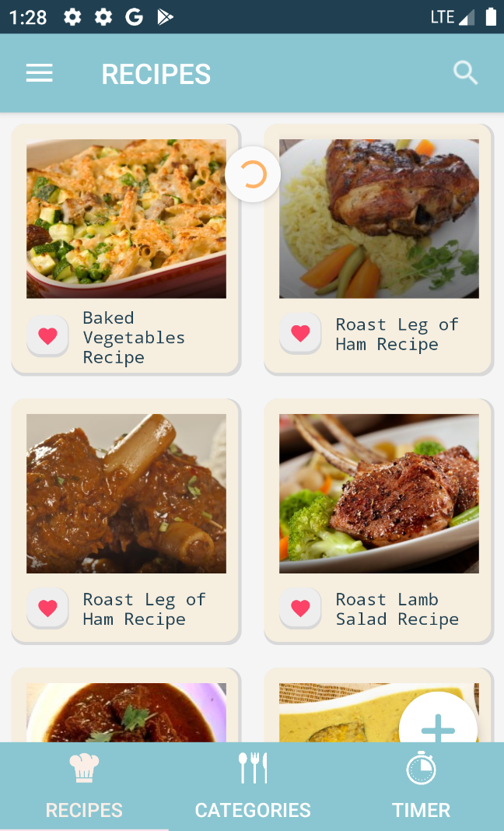
ANDROID FINAL PROJECT RECIPE
COMPONENT
1
2
3
4
1
DrawerLayout
5
CONTENTS. A
75%
21
ActionBarDrawerToggle
3
Toolbar
1
6
41
ProgressBar
5
RecyclerView
CONTENTS. A
75%
6
ViewPager
8
7
TabLayout
7
8
FloatingActionButton

Slide 35
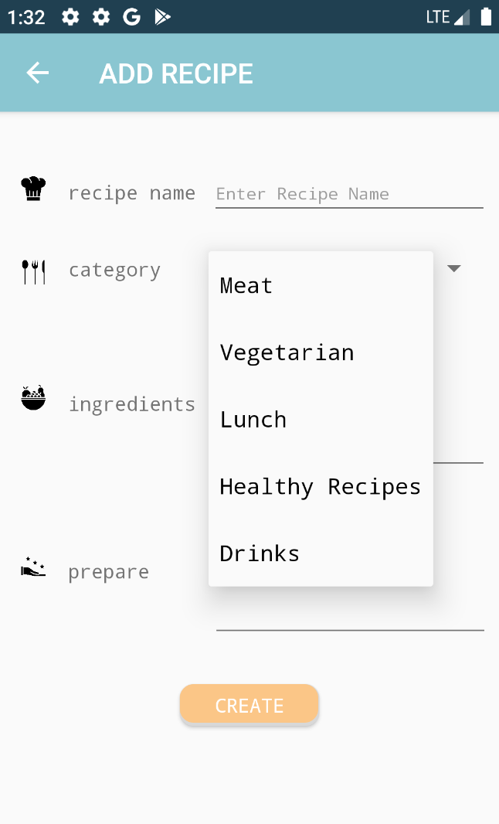
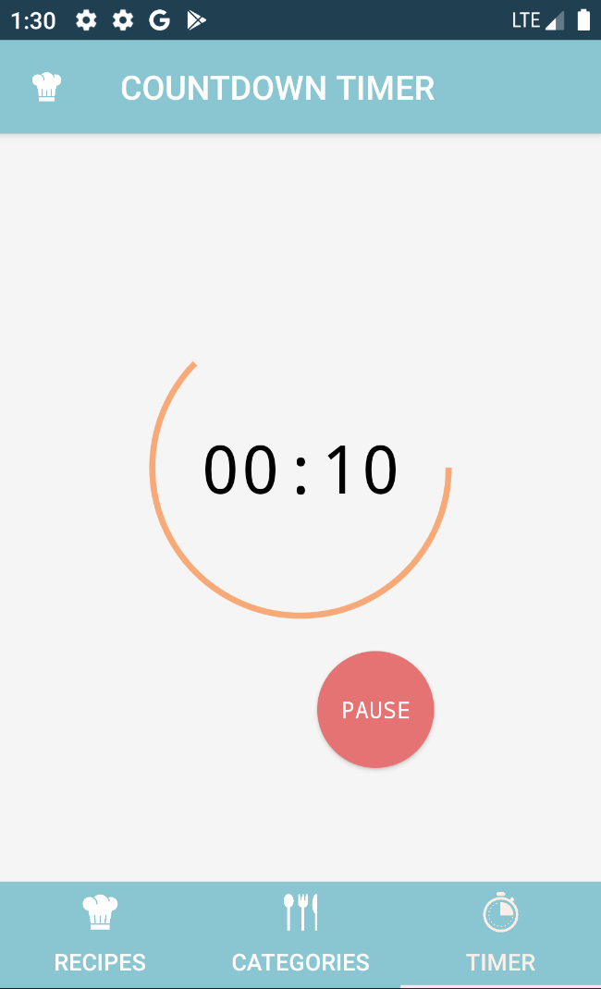
ANDROID FINAL PROJECT RECIPE
COMPONENT
1
2
CONTENTS. A
75%
3
1
Fragment
1
21
Spinner
4
3
ProgressBar
CONTENTS. A
75%
41
CountDownTimer

Slide 36
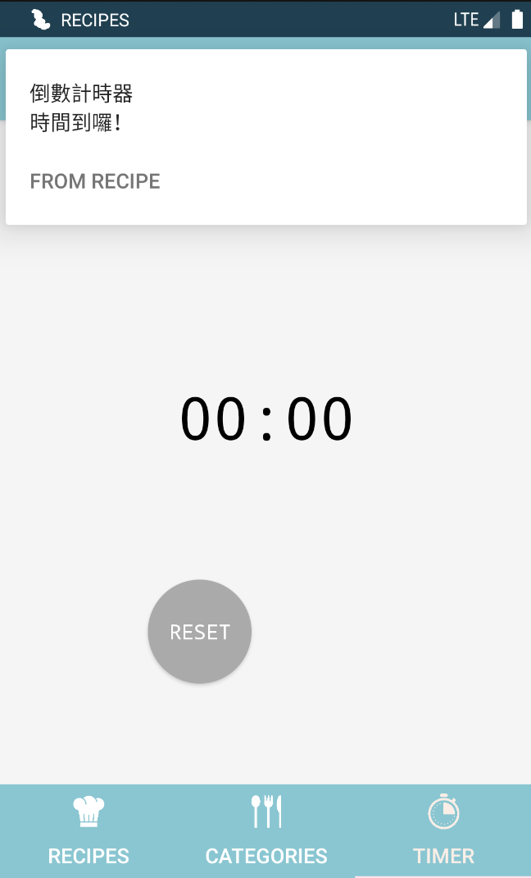
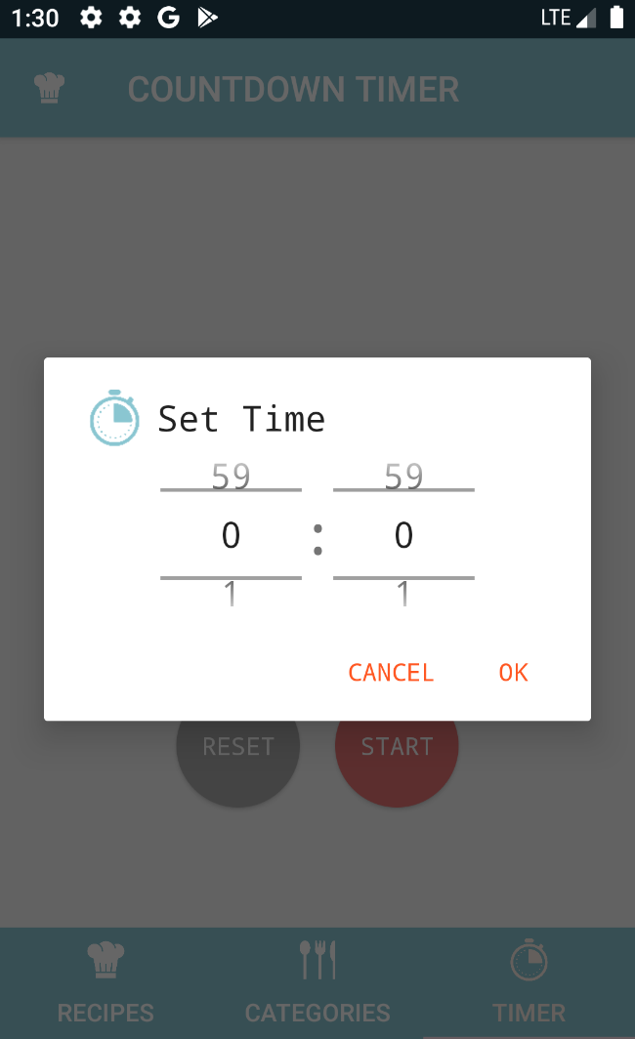
ANDROID FINAL PROJECT RECIPE
COMPONENT
1
1
4
2
CONTENTS. A
75%
2
3
1
Notification
3
1
21
AlertDialog
4
3
NumberPicker
CONTENTS. A
75%
41
MediaPlayer

